Slide 1

Online Sales vs Store Sales
AdventureWorks_DWH
Your logo

Slide 2
Table of Contents
01
About Dataset
02
Tool for Analysis
03
Problem and Question
04
Key Insight and Dashboard

Slide 3

01
About Dataset
Understanding all Dim Table and Fact Table

Slide 4

Dim Geography
Dim Product
There 10 total tables, but 6 tables use for analysis
Fact OnlineSales
Fact StoreSales
Dim Date
Dim SalesTerritory

Slide 5
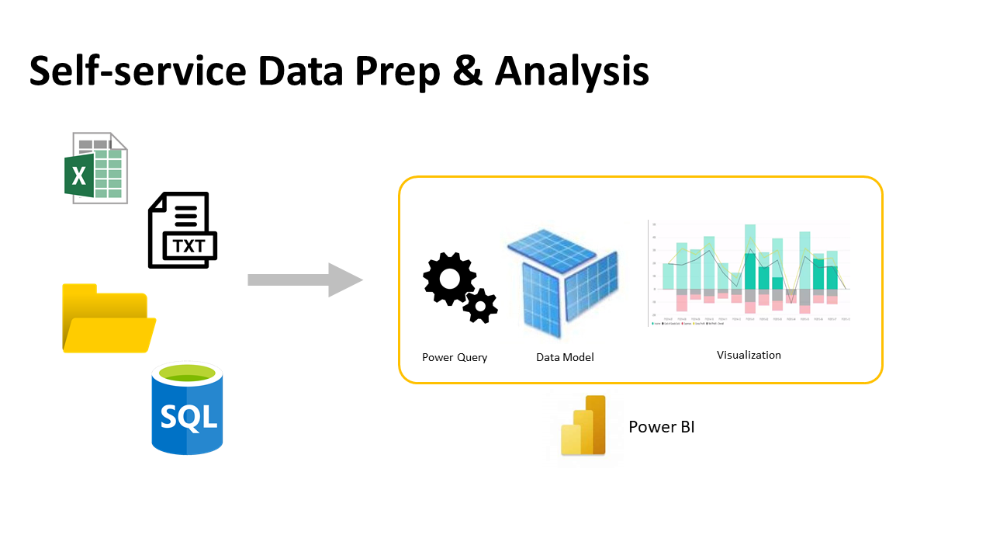
02
Tool for Analysis
Supported by Microsoft tool for visualization

Slide 6
Tool for Analysis
Excel (CSV)
SQL Server
Power BI
Use excel file in form of CSV (Dim Date), and clean in SSIS
Migrate data from SSIS to SQL server
Push data to Power BI, check model, and do visualization

Slide 7

03
Problem and Question
Problem Statement and Question before exploring insight

Slide 8
Problem and Question
What year and quarter sell the most products?
Which region that buy the most product?
Compare Online and Store, which type of sales that sell the most by Year & Quarter?
Compare Online and Store, what month that has the most shipping?
Compare Online and Store, which is the top 1 region both sales and quantities?

Slide 9
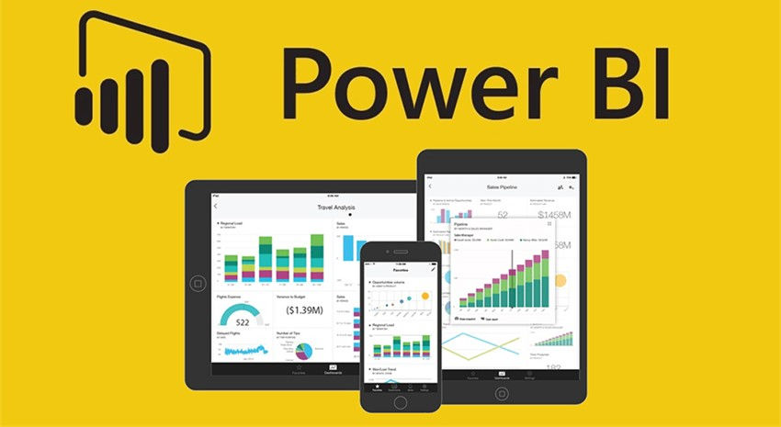
03
Key Insight and Dashboard
Let’s dive through insight in Power BI

